Slide 1
TornadoFX
The desktop is not dead

Slide 2

Kotlin:
Pragmatic java based language
Excellent for DSL design
Completely open source

Slide 3

JavaFX:
Modern CSS stylable desktop framework
Everything Swing should have been
Completely open source
Very very verbose

Slide 4

Combine the DSL strength of Kotlin with the power of JavaFX
TornadoFX turbocharges your desktop development

Slide 5
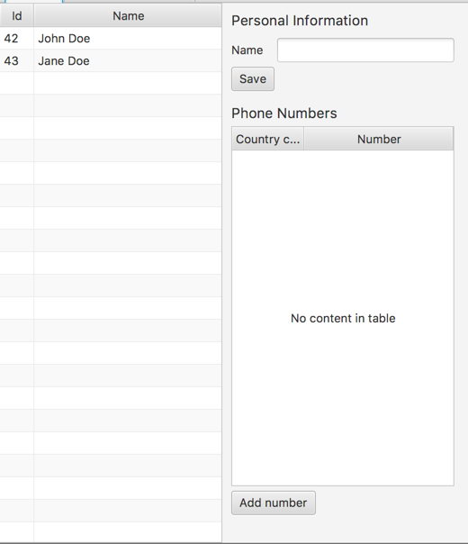
Built to support general desktop use cases like forms, tables, lists and trees.

Slide 6

Vibrant slack community

Slide 7
To the code

